Slide 1
Agenda & notices
Presented by
Shrishti Rai &
Sourav Jaiswal

Slide 2
What is Agenda ?
A list or outline of things to be considered or done.

Slide 3
Types of Agenda
Informal
Formal
Prioritized
Timed

Slide 4
Features of Agenda
Agenda is sent along with the notice.
The topics are determined by the secretary.
Controversial topics should be written .
It is written in brief but explicit manner.

Slide 5
Importance of Agenda
Agenda is circulated in advance.
Helps to take a prompt decision.
Ensure covering all the topics.
Control the unnecessary talking.

Slide 6
WHY Agenda ?

Slide 7

An Example of Agenda

Slide 8
notices

Slide 9

What is Notice ?
A Notice is written or printed news usually displayed publicly.
A notice can also be defined as a format designed to convey the same information to a number of different people.

Slide 10
Qualities of a good Notices
An effective notice:
Should be accurate, clear, concise and decisive correct, unambiguous, appropriate and polite language.

Slide 11
Notice for convening a meeting
A notice for convening a meeting contains following items.
Name of organization.
Place of meeting .
Date and time of meeting.
Purpose of meeting.

Slide 12
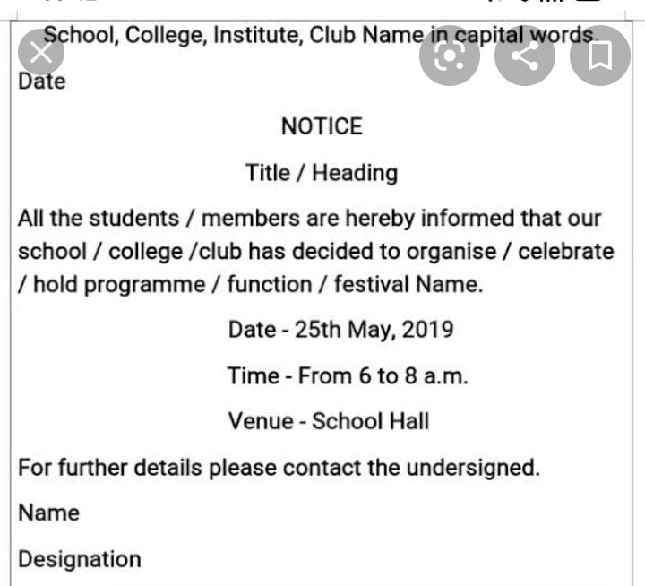
An Example of Notice

Slide 13
Thank you for your ATTENTION !
Hope you enjoyed

